Slide 1


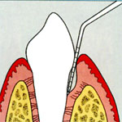
RUNGTA COLLEGE OF DENTAL SCIENCES AND RESEARCH,BHILAI
PERIODONTAL POCKET
Dr PUSHPENDRA YADAV
Sr Lecturer
Dept of Periodontology

Slide 2
SPECIFIC LEARNING OBJECTIVES
CORE AREAS | DOMAN | CATEGORY
Diagnosis | Cognitive | Must to know
Treatment | Pshycomotor | Nice to know

Slide 3
CONTENT
PART II
DIAGNOSIS
TREATMENT
SUMMARY
REFERENCE

Slide 4

PART -II
DIAGNOSIS

Slide 5
The 3 general approaches that have been used to clinically assess damage to periodontal tissues are:
Measurement of clinical attachment level with a periodontal probe
Visual detection of clinical signs of tissue destruction
Radiographic detection of bone loss

Slide 6
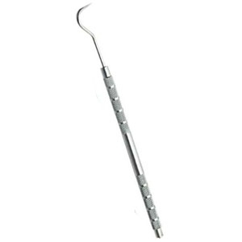
G.V. Black was the first to describe the systematic use of a probe to explore periodontal pockets.
“by the use of very thin flat explorers to determine the depth of pockets”.
These probes were apparently
uncalibrated.

Slide 7
Calibrated periodontal probes can be used to make 3 major types of measurements:
PROBING DEPTHS
CLINICAL ATTACHMENT LEVELS
RELATIVE ATTACHMENT LEVELS

Slide 8
Listgarten (1972)
Pocket Depths
Biologic or Histologic depth
Clinical or Probing depth

Slide 9
Biologic or Histologic depth
The biologic depth is the distance between the gingival margin and the base of the pocket (coronal end of junctional epithelium).
This can be measured only in carefully prepared and adequately oriented histologic sections.
Notes:
1.8 mm

Slide 10
Clinical or Probing depth
The probing depth is the distance to which an ad hoc instrument (probe) penetrates into the pocket.

Slide 11
Clinical or Probing depth
In humans the probe tip penetrates to the most coronal intact fibers of the connective tissue attachment.
The depth of penetration of the probe in the connective tissue apical to the junctional epithelium in a periodontal pocket is about
0.3 mm.
Notes:
This is important in evaluating differences in probing depth before and after treatment, because the reduction in probe penetration may be a result of reduced inflammatory response rather than gain in attachment.

Slide 12
Van der Velden (1979) through his experiment recommended a probing force of 0.75 N as optimal with probes of 0.63 mm in diameter.

Slide 13
Probing technique
The probe should be inserted parallel to the vertical axis of the tooth and “walked” circumferentially around each surface of each tooth to detect the areas of deepest penetration.

Slide 14
Notes:
A, In a normal sulcus with a long junctional epithelium (between arrows), the probe penetrates about one-third to half the length of the junctional epithelium. B, In a periodontal pocket with a short junctional epithelium (between arrows), the probe penetrates beyond the apical end of the junctional epithelium

Slide 15
The depth of penetration of a probe in a pocket depends on such factors as:
Diameter of the probe,
Force of its introduction,
Direction and angulation of probe penetration,
Resistance of the tissues, and
Convexity of the crown
Notes:
Because of these and other sources of variation, manually operated conventional periodontal probes have an average measurement error of ±1 mm.

Slide 16
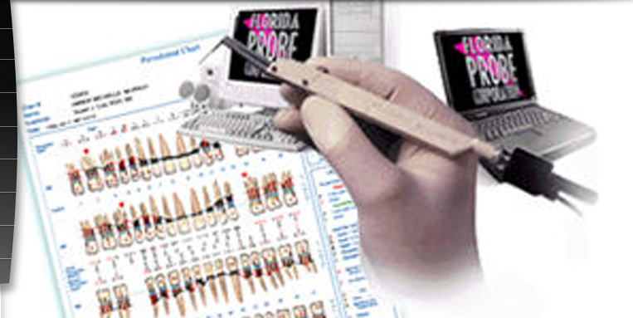
In an attempt to overcome some of the variables associated with periodontal probing, several new types of probes have been invented that includes the Florida probe, Toronto probe, Foster-Miller (Alabama) probe and
Interprobe.
Notes:
Virtually all of these probes use controlled insertion forces and have in vitro resolution of 0.1-0.5 mm. Since they are linked to a computer they all have the advantage of direct data entry.
All automated controlled-force probes have two main drawbacks: 1) reduced tactile sense of the operator and 2) increased patient discomfort

Slide 17
Clinical attachment level
It is the distance from the cementoenamel junction to the base of the pocket.
It is a clinical approximation of the loss of connective tissue attachment from the root surface.

Slide 18
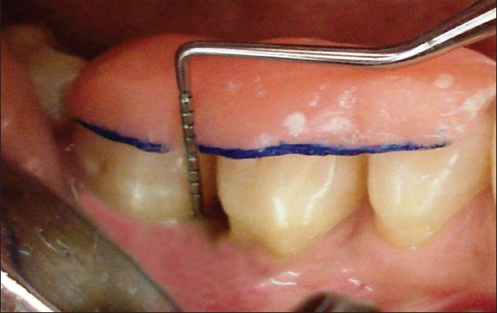
In such situations, another fixed landmark such as a stent or the margin of a restoration can be used to obtain a measurement called the relative attachment level.
Notes:
When the cementoenamel junction is not detectable or is missing due to a dental restoration, the clinical attachment level cannot be measured.

Slide 19
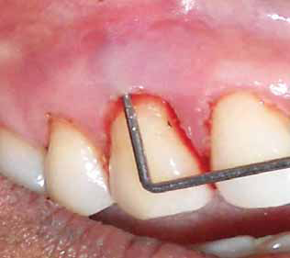
Bleeding on Probing
The insertion of a probe to the bottom of the pocket elicits bleeding if the gingiva is inflamed and the pocket epithelium is atrophic or ulcerated.
Notes:
As a single test, bleeding on probing is not a good predictor of progressive attachment loss, however, its absence is an excellent predictor of periodontal stability. When present in multiple sites of advanced disease, bleeding on probing is a good indicator of progressive attachment loss

Slide 20
When to Probe
Probing of pockets is done at various times for diagnosis and for monitoring the course of treatment and maintenance.
Initial probing
Second probing
Probing around implants

Slide 21
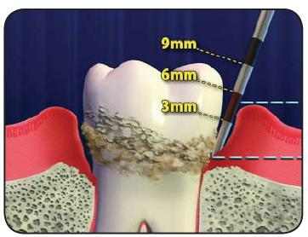
The initial probing of moderate or advanced cases is usually hampered by the presence of heavy inflammation and abundant calculus and cannot be done accurately.
Notes:
The purpose of this initial probing, however, together with the clinical and radiographic examination, is to determine whether the tooth can be saved or should be extracted.

Slide 22
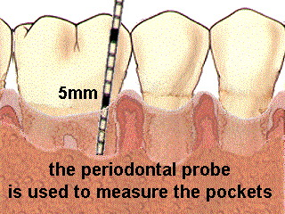
The second probing: After the patient has performed adequate plaque control over time and calculus has been removed, the major inflammatory changes disappear, and a more accurate probing of the pockets can be performed.
.
Notes:
The purpose of this second probing is to establish accurately the level of attachment and degree of involvement of roots and furcations

Slide 23
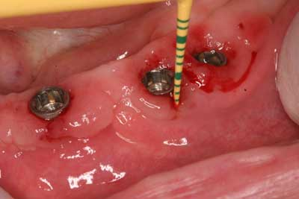
Probing around implants:
To prevent scratching of the implant surface, plastic periodontal probes should be used.
Notes:
Periimplantitis can create pockets around implants, so probing around the implants becomes part of the examination and diagnosis.

Slide 24
RADIOGRAPHIC INTERPRETATION

Slide 25
Pockets are not detected by radiographic examination.
The periodontal pocket is a soft tissue change. Radiographs indicate areas of bone loss where pockets may be suspected; they don’t show pocket presence or depth, and thus they show no difference before or after pocket elimination unless bone has been modified.

Slide 26
Gutta percha points or calibrated silver points can be used with the radiograph
Notes:
Gutta percha points or calibrated silver points can be used with the radiograph to assist in determining the level of attachment of periodontal pockets. They may be used effectively for individual pockets or in clinical research, but their routine use throughout the mouth would be rather cumbersome.

Slide 27
Methods for the detection of periodontal pathogens
Phase contrast and darkfield microscopy
Bacterial culture
Immunological assays
DNA Probes
Polymerase chain reaction
Enzyme-based assay

Slide 28
TREATMENT

Slide 29
Non-surgical periodontal therapy
Surgical therapy

Slide 30
The various treatment modalities available in non surgical periodontal therapy are:
Mechanical therapy
Systemic antibiotics
Subgingival irrigation
Local drug delivery
Host modulation therapy

Slide 31
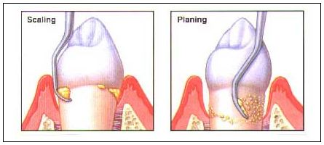
Mechanical therapy
Consists of debridement of the roots by the meticulous use of hand or power-driven scalers to remove plaque, endotoxin, calculus and other plaque-retentive local factors.
Notes:
The term mechanical therapy refers to both supragingival and subgingival scaling as well as root planning. The removal of all tooth deposits is considered the first step of therapy directed at inflammation and pocket depth reduction.

Slide 32
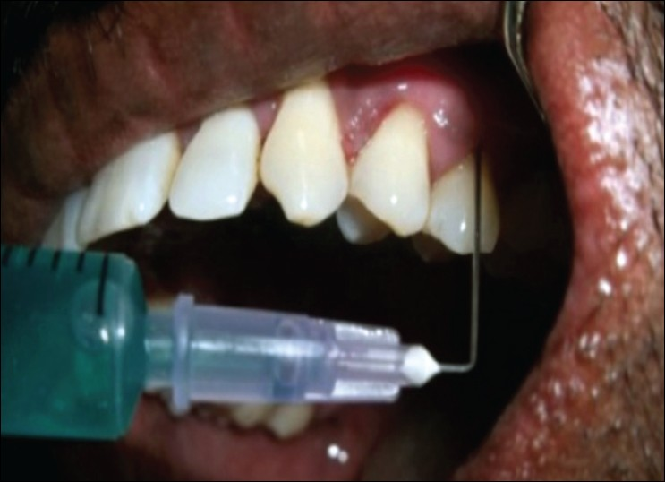
Full mouth disinfection
The FMD was proposed by the research group of Leuven University in 1995 as a new treatment strategy.
Notes:
The rationale of this approach is to eradicate or at least suppress all periodontal pathogens in a short time not only from the periodontal pockets but also the entire oropharyngeal cavity so that the recolonisation of the pockets by bacteria residing non-treated pockets and other oral sites is prevented.

Slide 33
To achieve the above aims, Quirynen and his co-workers proposed full mouth scaling and debridement in two visits within 24 hours.
additional irrigation of the pockets with 1% chlorhexidine gel
use of chlorhexidine mouthrinse and spray chairside
patients’ daily oral hygiene regimen of chlorhexidine mouthwash
for a period of two months to retard the recolonisation of the pockets

Slide 34
Subgingival irrigation
Subgingival irrigation penetrates much deeper in to the pocket, are more effective in flushing out the bacteria and significant improvements in gingival health.
Several irrigant solutions include 0.2% chlorhexidine digluconate, 0.5% tetracycline, 0.5% metronidazole, 0.02% stannous fluoride

Slide 35
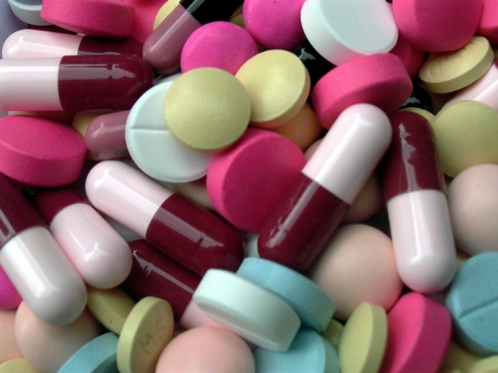
Systemic antibiotics
Sites with deep periodontal pockets, grooves, furcations, and concavities are difficult to access with periodontal instruments. Thus periodontopathic bacteria may remain in those sites.
Notes:
. However, conventional mecIn such cases, antimicrobial agents may help to further suppress periodontal pathogenshanical root debridement does not usually eradicate all periodontopathic bacteria from the subgingival ecosystem.

Slide 36
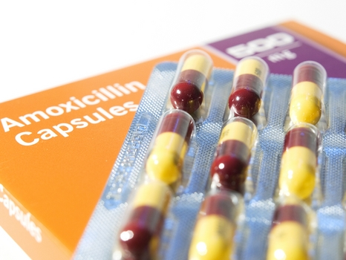
Various systemic antibiotic used:
Penicillin-Augmentin, Amoxycillin
Tetracycline-Tetracycline, Minocycline, Doxycycline
Quinolone- Ciprofloxacin
Lincomycin-Clindomycin
Nitroimidazle –Metronidazole
Macrolide-Azithromycin

Slide 37
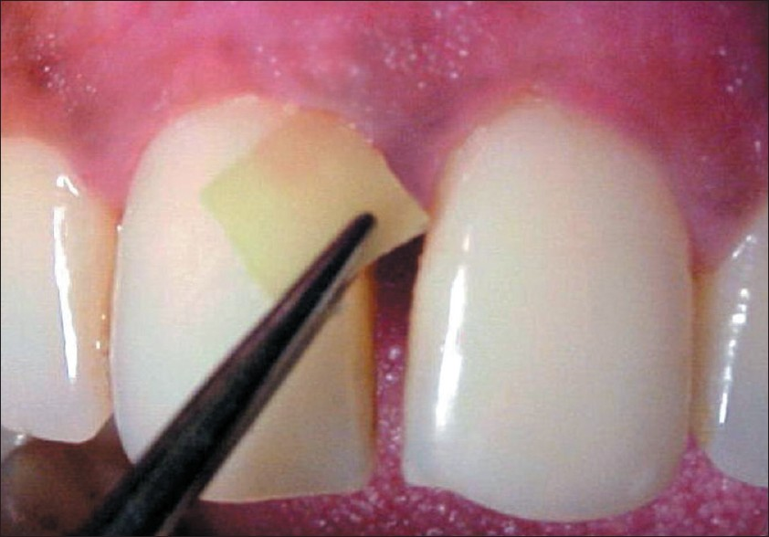
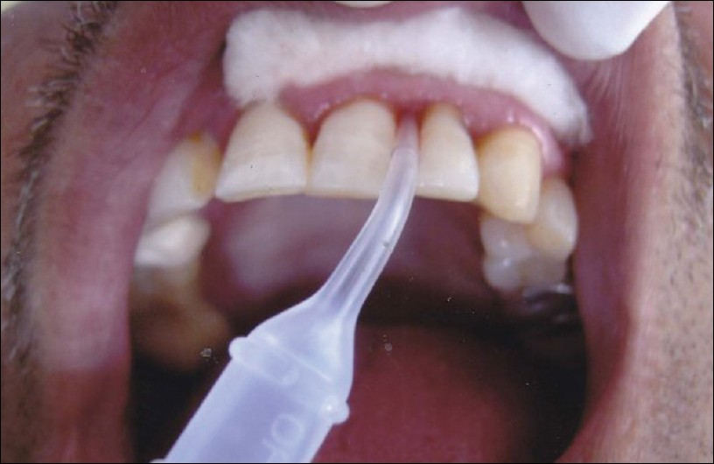
Local drug delivery
Tetracycline, minocycline, doxycycline, and metronidazole have been used in sustained delivery devices.
Notes:
The disadvantage of local antimicrobial therapy is the difficulty of placing therapeutic concentrations of the antimicrobial agents into deeper parts of periodontal pockets or furcation lesions. Thus, topical antimicrobials may not be adequate to eliminate all periodontopathic bacteria. The efficacy of locally applied antimicrobial agents in periodontal therapy also depends on whether there is sufficient contact time between the antimicrobial agent and the target microorganisms

Slide 38
The following medications are the most often prescribed –
Actisite
Atridox
Arestin
PerioChip
Elyzol

Slide 39
Host modulation therapy ( HMT)
HMT is a means of treating the host side of the host-bacteria interaction. The host responses responsible for most of the tissue breakdown leading to the clinical signs of periodontitis.

Slide 40
Sub-antimicrobial doxycycline (SDD) is a 20 mg dose of doxycycline (periostat) that is FDA approved and indicated as an adjunct to SRP in the treatment of chronic periodontitis

Slide 41
Lasers
Laser therapy has bactericidal and detoxification effects, and it can remove epithelial lining, granulation tissue, plaque and calculus within the periodontal pocket with low mechanical stress and without leaving a smear layer on root surface. Claffey & Polyzois 2008

Slide 42
SURGICAL THERAPY

Slide 43
Pocket Reduction Surgery
Resective--gingivectomy, apically displaced flap and undisplaced flap with or without osseous resection.
Regenerative--flaps with grafts, membranes, etc.
Notes:
Pocket elimination consists of reducing the depth of periodontal pockets to that of a physiologic sulcus to enable cleansing by the patient.

Slide 44
Gingivectomy
This technique is aimed at reducing deep gingival pockets formed by enlarged fibrotic tissue and suprabony periodontal pockets.
not indicated in the reduction of infrabony pockets because the incision cannot reach the base of the pocket due to intervening bone.
If used for pockets extending to or beyond the mucogingival junction, the entire zone of keratinized gingival is lost.

Slide 45
Complete healing of the gingivectomy wound takes 4–5 weeks, although by clinical inspection the surface of the gingiva may appear to be healed already after approximately 14 days. Ramfjord et al. 1966

Slide 46
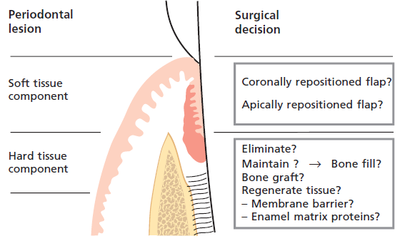
Surgical decisions. Treatment decisions with respect to the soft and the hard tissue component of a periodontal pocket
Notes:
Surgical therapy deals with:
(1) the soft tissue component and
(2) the hard tissue component of the periodontal pocket at a specific tooth site.

Slide 47
SUMMARY
Although periodontal pocket formation/periodontitis is a pathologic process, and the host response that causes the tissue destruction, is aimed to restrict the spreading of the infection into deeper areas.
Despite of a huge number of studies on periodontitis development, we still do not have a clear picture of the crucial events leading to the periodontal tissue destruction.

Slide 48
References
Newman M, Takei H, Klokkevold P, Carranza F. Clinical Periodontology. 10th ed. W.B. Saunders; 2006.
Lindhe J, Lang NP and Karring T. Clinical Periodontology and Implant Dentistry. 6th ed. Oxford (UK): Blackwell Publishing Ltd.; 2015.
Newman MG, Takei HH, Klokkevold PR, Carranza FA. Carranza’s clinical periodontology, 13th ed. Saunders Elsevier; 2018.

Slide 49


